Slide 1

Smart Recommendation System
using ML
Group No. 27
Sakshi Naik-17104059
Sayali Phowakande-17104056
Arjun Rajput
Project Guide and Coguide
Prof. Apeksha Mohite
Prof. Geetanjali Kalme

Slide 2
Contents
Introduction
Objectives
Problem Definition
Technological Stack
Review Suggestions (Given in Last meeting)
Proposed System Architecture/Working
Prototype Design Demonstration
Implementation Status
Status of Paper Draft & Targeted Conference

Slide 3
1. Introduction
Rapid development of mobile devices and internet has made possible for us to access different music resources freely.
The number of songs available exceeds the listening capacity of single individual.
People sometimes feel difficult to choose from millions of songs. Moreover, music service providers need an efficient way to manage songs and help their costumers to discover music by giving quality recommendation.
Thus, there is a strong need of a good recommendation system.

Slide 4
2. Objectives
To provide cross platform application and Chatbot to interact with user.
To provide recommendation based on recorded information on the user’s preferences.
To deliver a set of playlist from estimating the current and future popularity of songs ,artist and genres.
To keep track on frequently played songs.

Slide 5
3. Problem Definition
People sometimes feel difficult to choose from millions of songs. Moreover,
music service providers need an efficient way to manage songs and help their
users to discover music by giving quality recommendation.
Sometimes just recommending doesn't give user satisfactory outcome to avoid this problem chatbot is introduce to make more personalized recommendation.

Slide 6
4. Technology Stack
Frontend:
Flutter
Backend:
BigQuery
TensorFlow
Firebase
Algorithms :
Hybrid Algorithm ( Collaborative Filtering and content based )
AI Chatbot :DialogueFlow-Flutter Library
Chatbot : Using Rasa and Python

Slide 7
5. Review Suggestions (Given in Last meeting)
Scope of the project to be redefine.
Check feasibility, if project can be developed for cross platform(flutter)
Objective should be clearer.
Firstly user will have interface were user can interact with chatbot.
From interaction, Mood or genre of music user should be fetch.
As per the interest song should be pushed to the user interface.

Slide 8
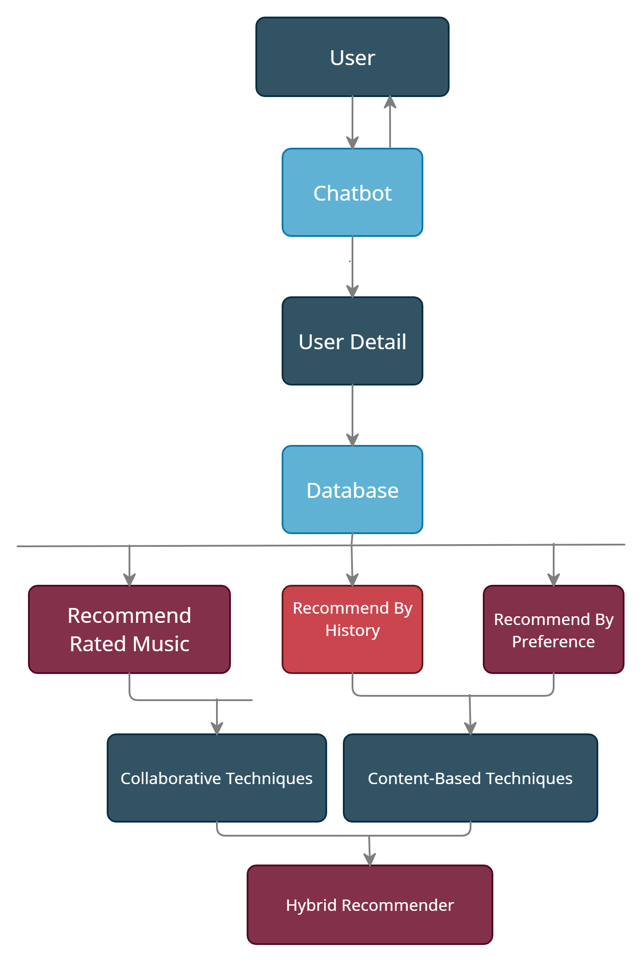
6. Block Diagram to propose project Idea

Slide 9
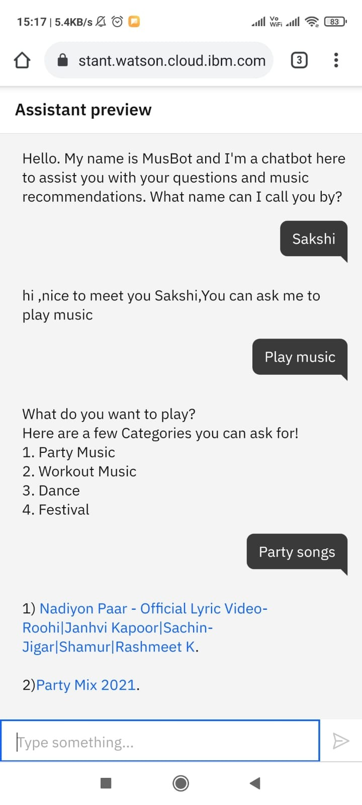
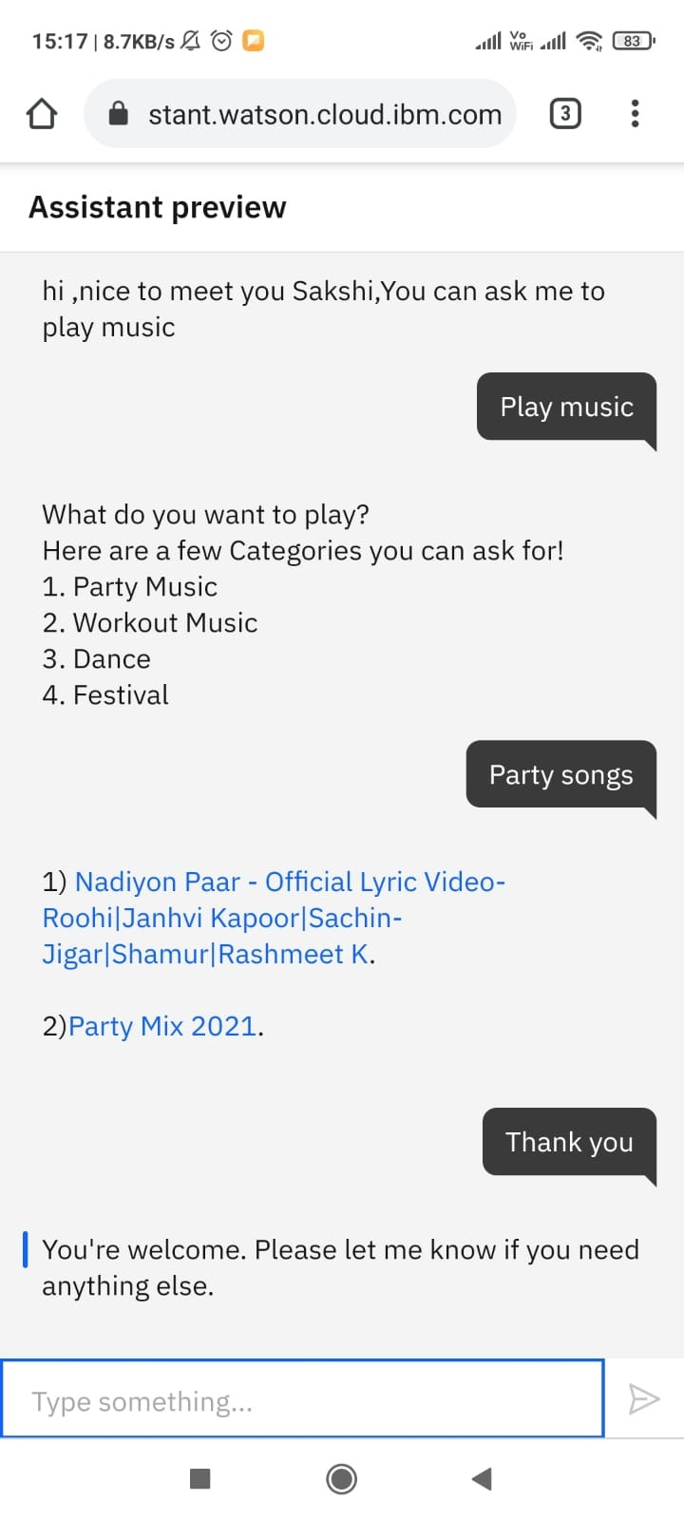
7. Prototype Design Demonstration

Slide 10
Implementation Status
Aug-Sept’21
January’22

Slide 11
Targeted Conference
3rd International Conference on Deep Learning, Artificial Intelligence and Robotics, (ICDLAIR) 2021
Abstract Deadline: September 05, 2021
Paper Submission Deadline: January 15, 2021
International Conference On Big Data, Machine Learning and Applications
Paper Submission Deadline: September 25, 2021

Slide 12
Thank You...!!

